Slide 1


BYU Management Society Africa Business Plan Competition 2026
MULLA GLOBAL SYSTEMS LIMITED

Slide 2
Problem / Customer Pain Point
Over 85 million Nigerians live without reliable electricity, and small businesses lose millions of Naira yearly to power outages and fuel costs. This unreliable power limits productivity, education, and healthcare, especially in developing communities.
Our Target Pain Points:
Frequent blackouts halting business operations.
High cost of generators and fuel.
Lack of affordable, sustainable power options, and flexible payment options for solar solutions.
High cost of electricity tariffs; this means the masses have to live with power outages or spending more on fuel/diesel which is not pocket friendly.

Slide 3
Business Venture / Product & Services
Solar by Mulla Inc. is a reliable energy company on a mission to make solar power accessible, affordable, and transformative for Nigerian homes and small businesses.
We offer:
Solar installations and maintenance for homes, shops, mini estates, business companies, and churches.
How We Solve It:
Our strength lies in our direct experience and our affordability strategy.
We design solutions that last long, perform well, and remain affordable by sourcing verified high-quality solar equipment from the U.S. and Canada. This allows us to deliver premium energy systems at a price people can actually afford.
Flexible payment: buy now, pay later plan.

Slide 4
Market Size & Growth
Nigeria’s solar energy market is projected to exceed $2 billion by 2027, fueled by rising fuel costs, unreliable grid infrastructure, and national clean energy initiatives. Market value: Over ₦500 Million annually within the Lagos and Abuja regions. (Source: REA, Nigeria Energy Transition Plan). Target Market:
Urban and Rural SMEs and Small Companies
Residential Homes
Churches
Competitors:
Luminous Inverter, Arnergy, and Rubitec Solar
MULLA’s Advantage: The aforementioned are established players with solid tech but limited in:
Affordability for low-income users. Flexible payment options. Rural, lower and middle class focus.

Slide 5
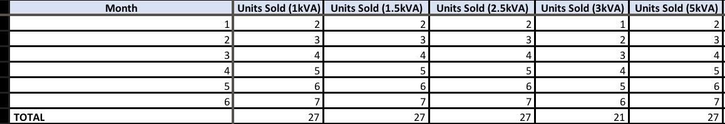
Marketing & Sales Strategy
Channels:
Direct marketing and Referrals.
Social media campaigns.
Partnerships with estate developers.
Government Partnership(vendors)
Sales Plan:
Target 27 installations in 6 months.(as Shown in the image)
Offer free consultations to attract new clients.
Incentivize referrals with discounts.

Slide 6
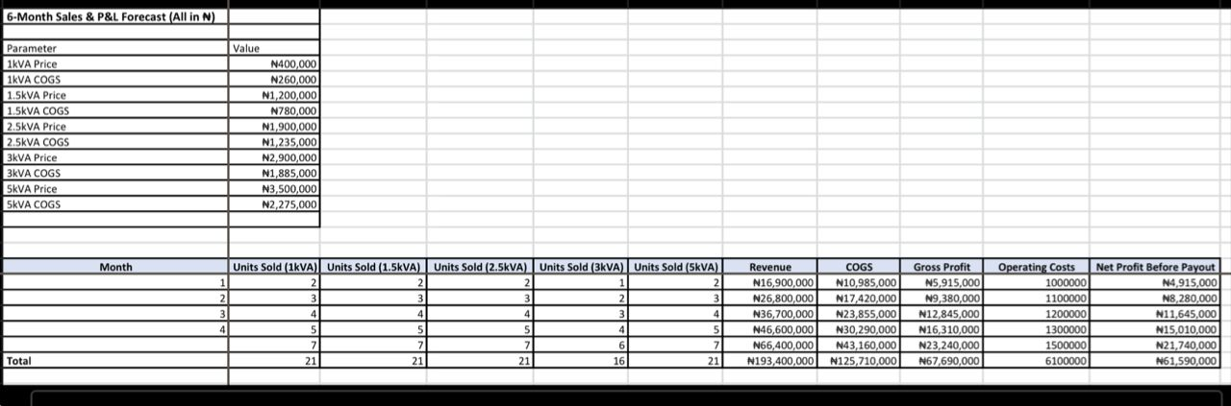
Financials (Six-month Forecast Summary)
Period | Revenue (₦) | Gross Profit (₦)
1-6 Months | ₦193,400,000($174,000) | ₦67,690,000($47,000)

Slide 7
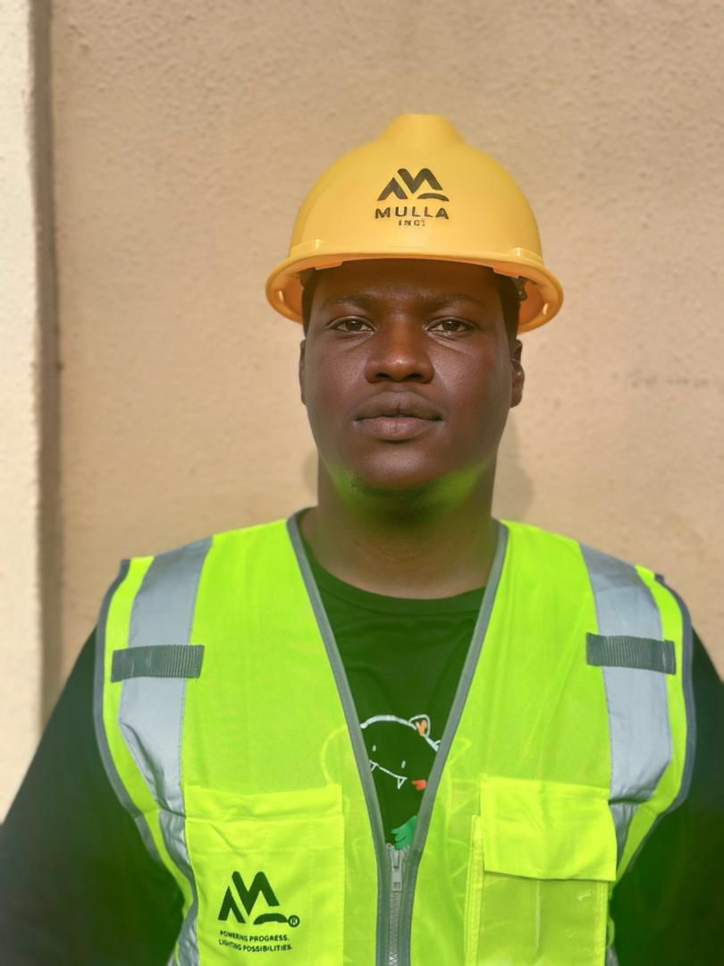
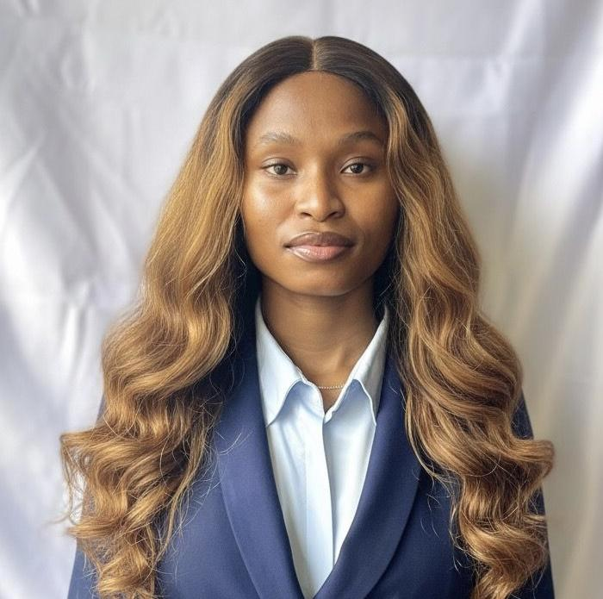
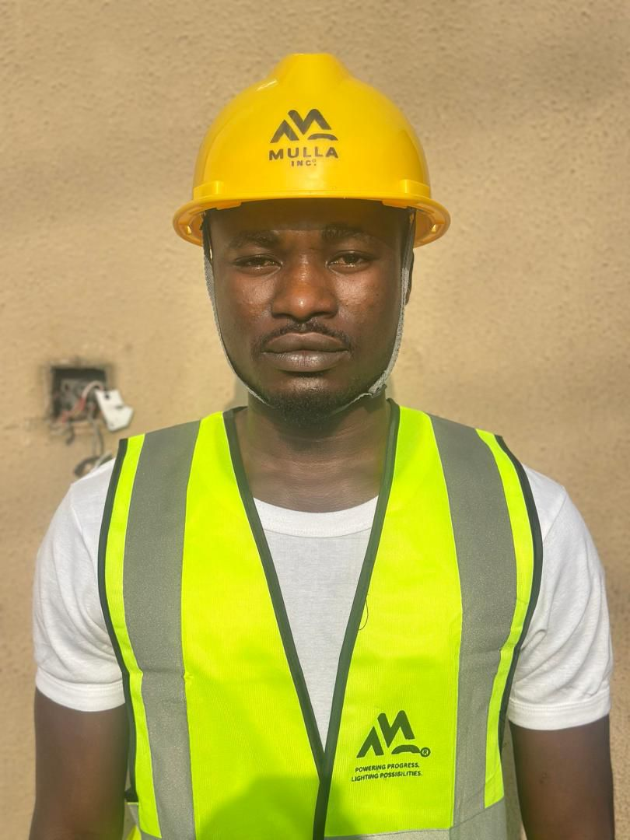
Management Team
Adebiyi Ademola Ayomide — Lead Engineer & Founder Visionary founder of Mulla Inc., with years of experience in solar installations, system design, and project execution. Passionate about sustainable energy and community impact!
Ulokameje Chiamaka Favour — Marketing & Customer Relations Lead Oversees marketing strategy, client communications, and customer satisfaction. Dedicated to building trust and long term relationships with clients and partners!
Tochukwu Simon Edena — Technician & Apprentice Responsible for technical support, field installations, and maintenance services. Currently undergoing professional training under Mulla Inc. to become a certified solar engineer.

Slide 8
Community Impact
Mulla Inc.™ empowers communities through:
Free training workshops for young technicians.
Free solar/inverter maintenance to businesses owned by aged seniors and health centers.
Promoting Employment in our society.

Slide 9
Use of Prize Money
1st Place – $4,000 (₦6,000,000)
Secure office space and Set up ₦3,000,000
Procure new 2kVA solar system for the office ₦1,500,000
Print and distribute branded marketing materials ₦500,000
Website and digital marketing setup ₦500,000
Employment of 1 Engineer and 1 additional Marketer ₦500,000
3rd Place – $2,000 (₦3,000,000)
Secure office space and Set up ₦1,500,000
Procure new 1kVA solar system for the office ₦600,000
Print and distribute branded marketing materials ₦400,000
Website and digital marketing setup ₦500,000
2nd Place – $3,000 (₦4,500,000)
Secure office space and Set up ₦2,500,000
Procure new 1.5kVA solar system for the office ₦1,000,000
Print and distribute branded marketing materials ₦500,000
Website and digital marketing setup ₦500,000
4th Place – $1,500 (₦2,225,000)
Secure office space and Set up ₦1,500,000
Print and distribute branded marketing materials ₦300,000
Website and digital marketing setup ₦400,000

Slide 10
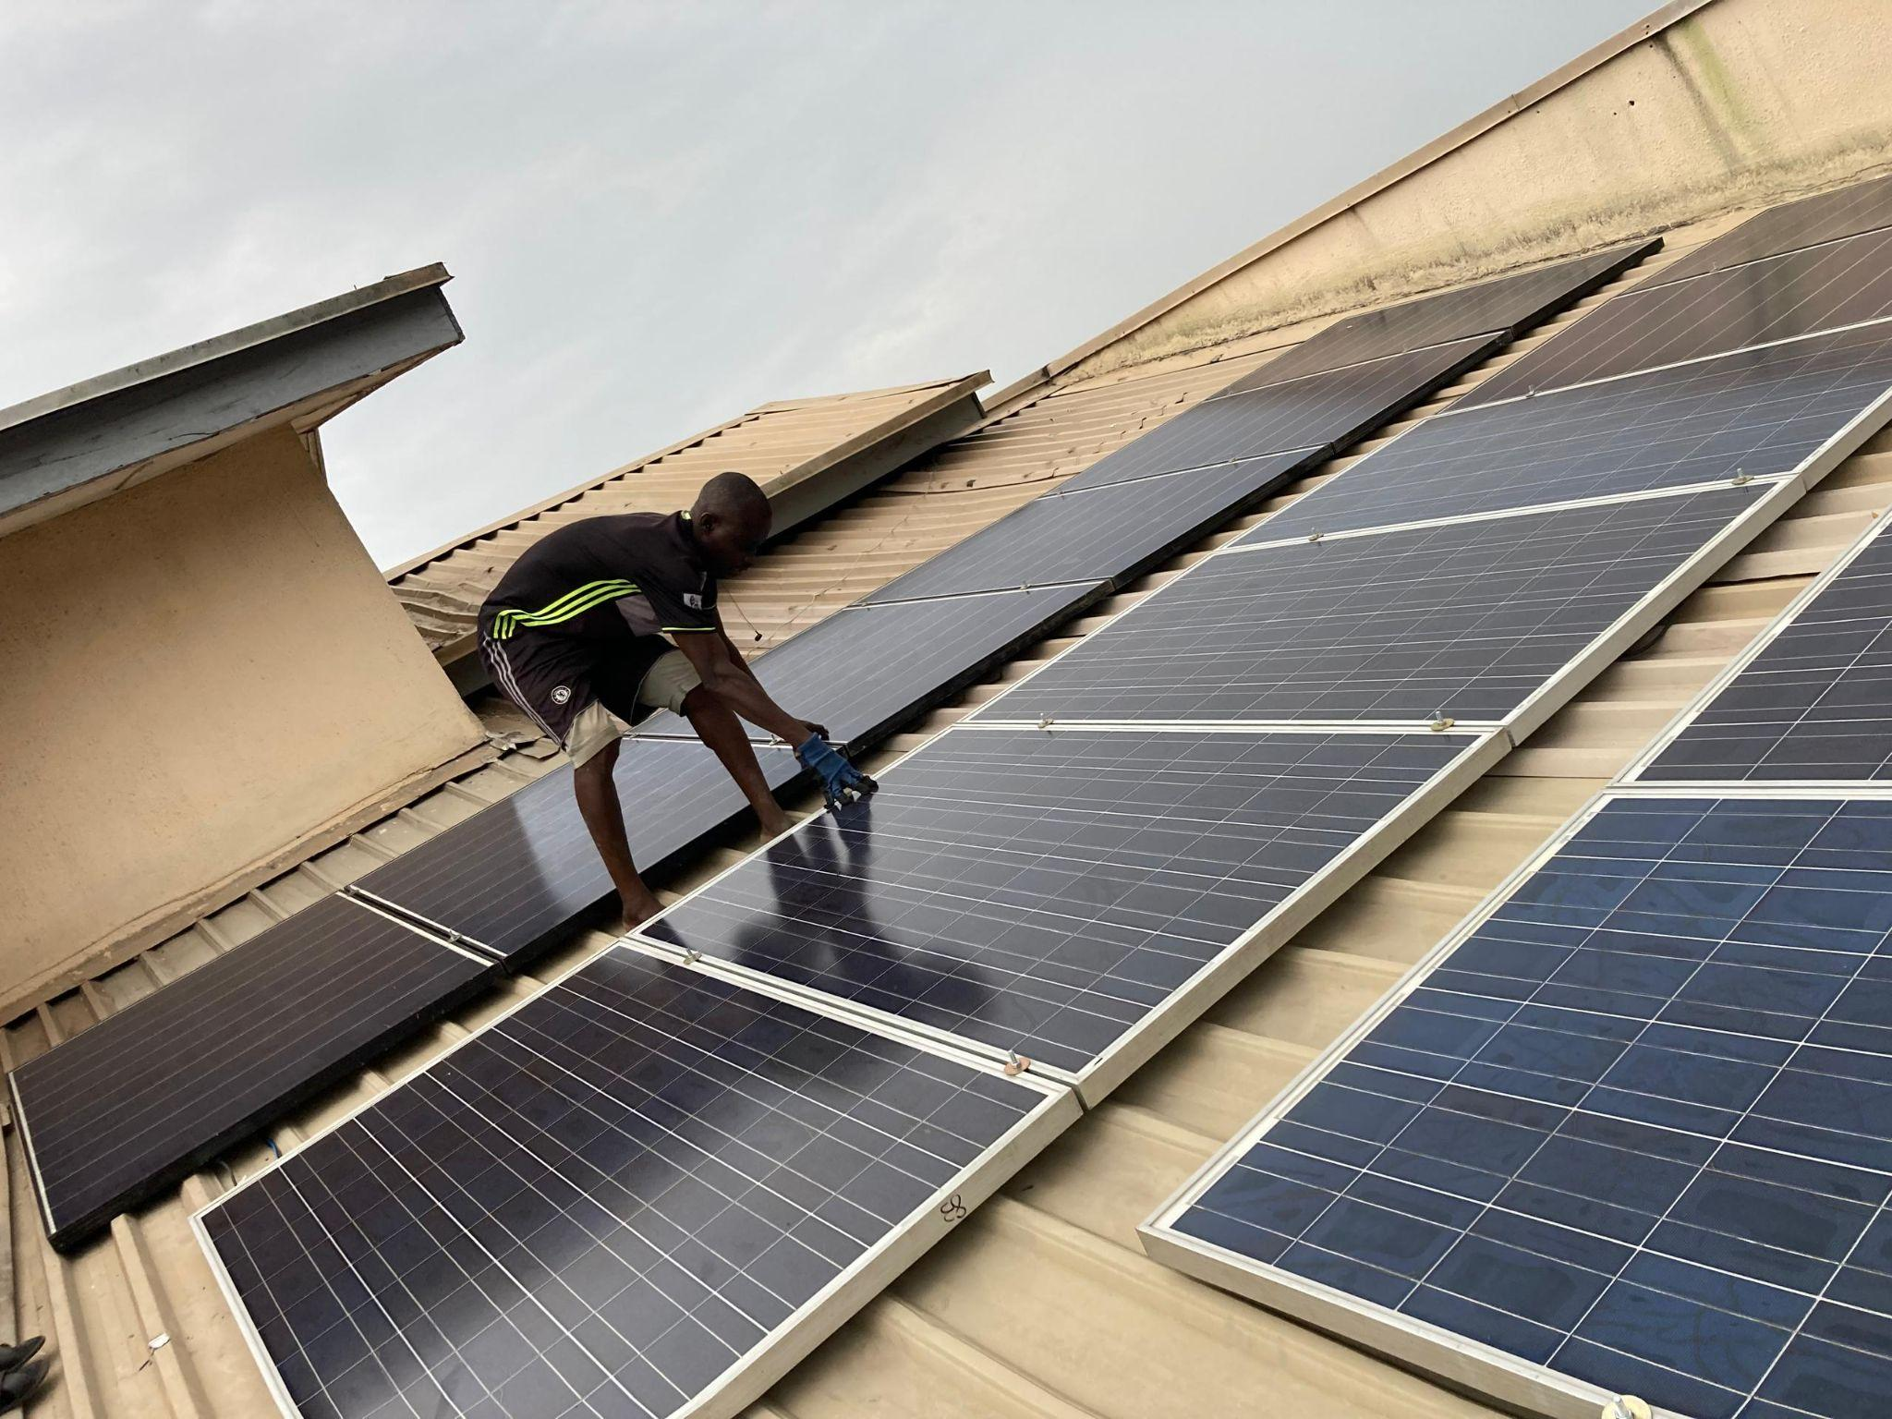
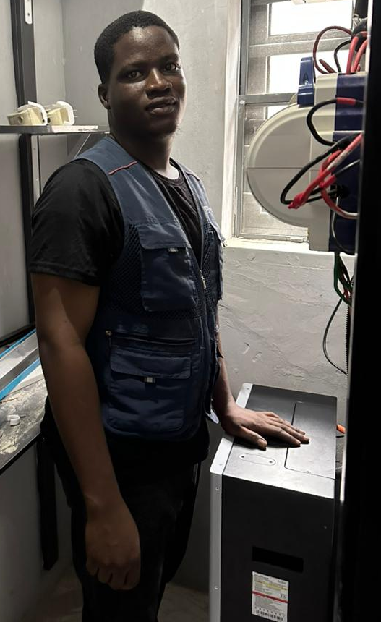
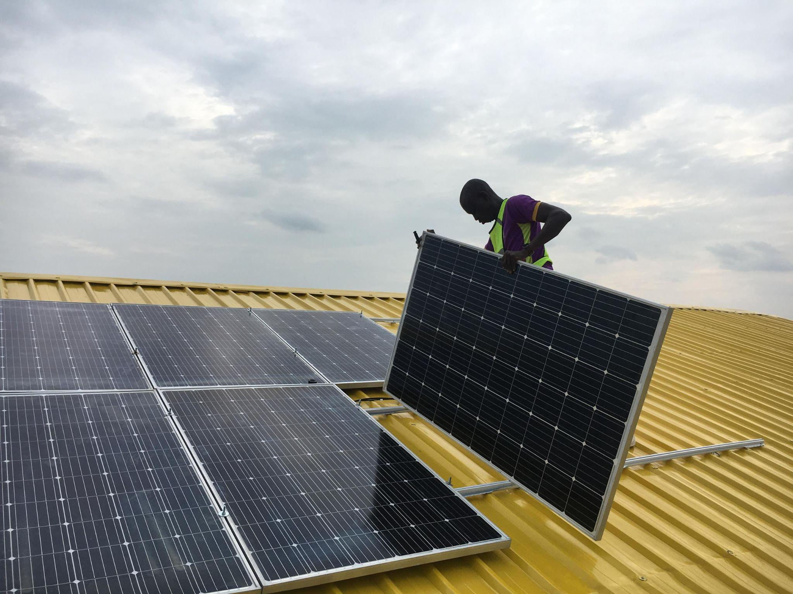
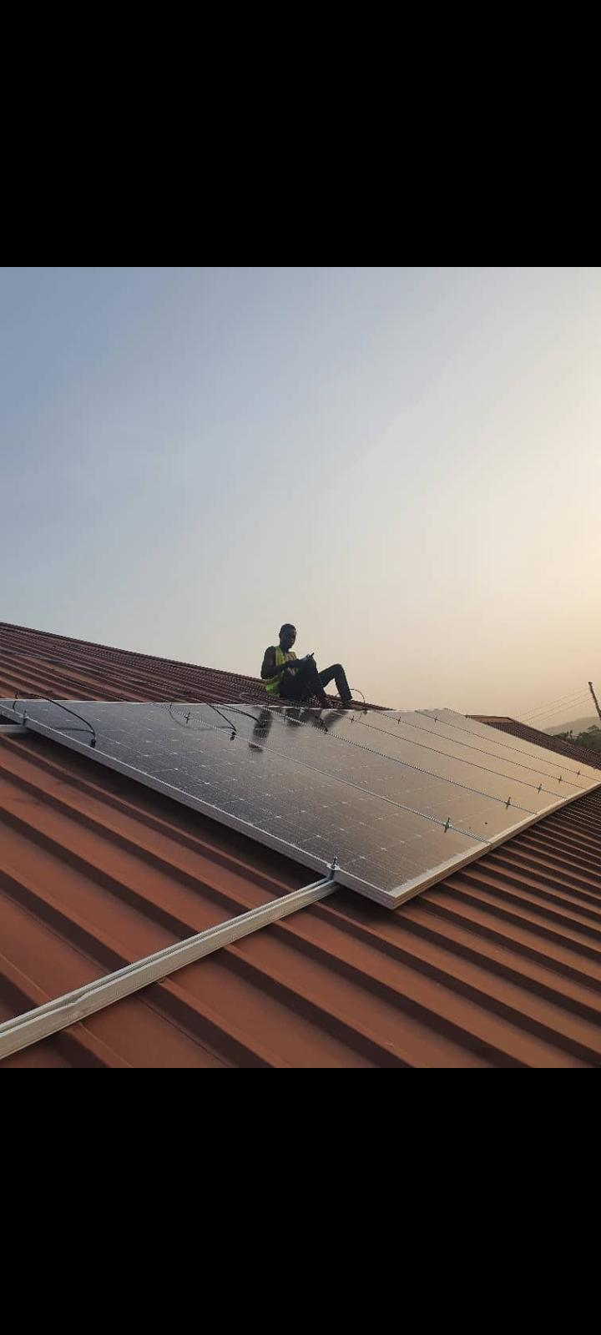
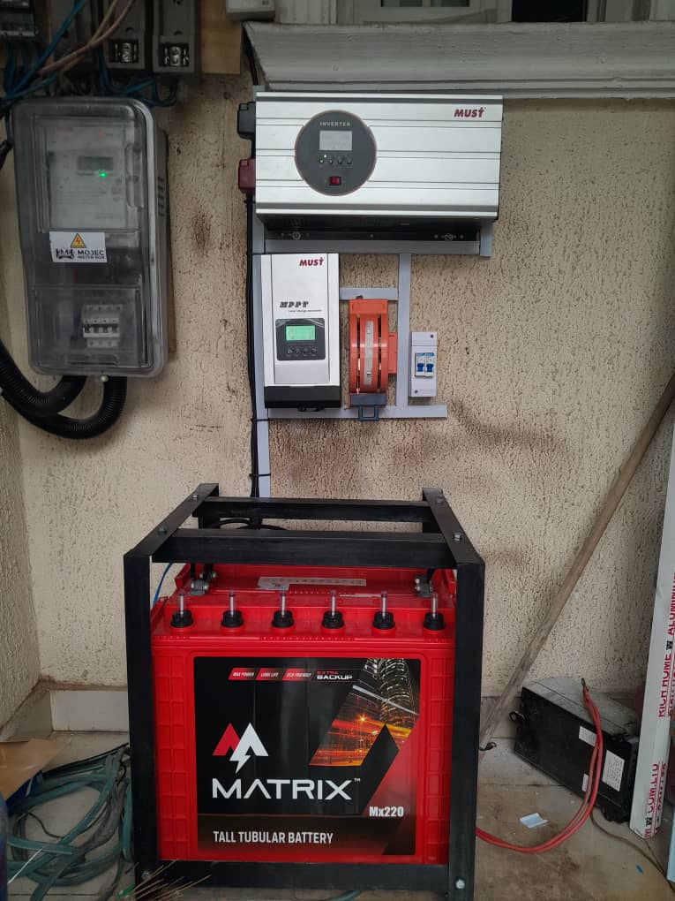
Photos of your business

Slide 11
Closing Vision
I started Solar by Mulla Inc. after leaving my previous boss in April 2025, following several years of hands on experience managing installations, clients, and field operations. During that time, I gained deep technical expertise, built relationships with my own personal clients, and learned how to deliver with excellence and integrity.
Those experiences shaped my confidence and purpose. When I received the competition email, it felt like divine confirmation for a chance to turn that conviction into a lasting legacy of light, trust, and impact through Mulla Inc.
Solar by Mulla Inc.™ Powering Progress, Lighting Possibilities.

Slide 12
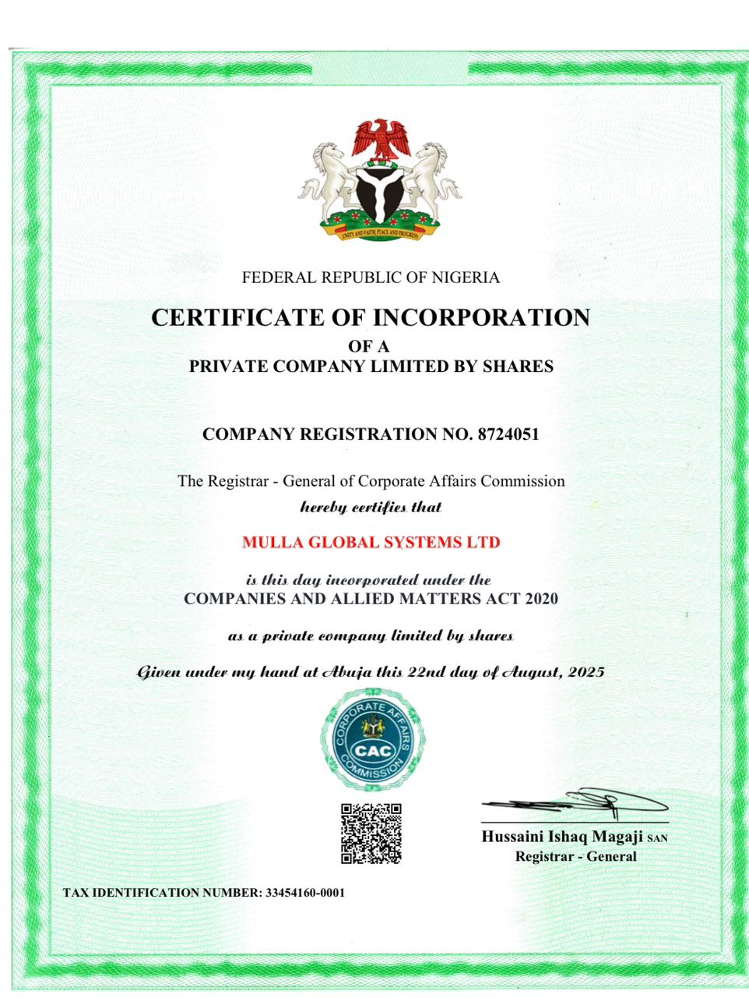
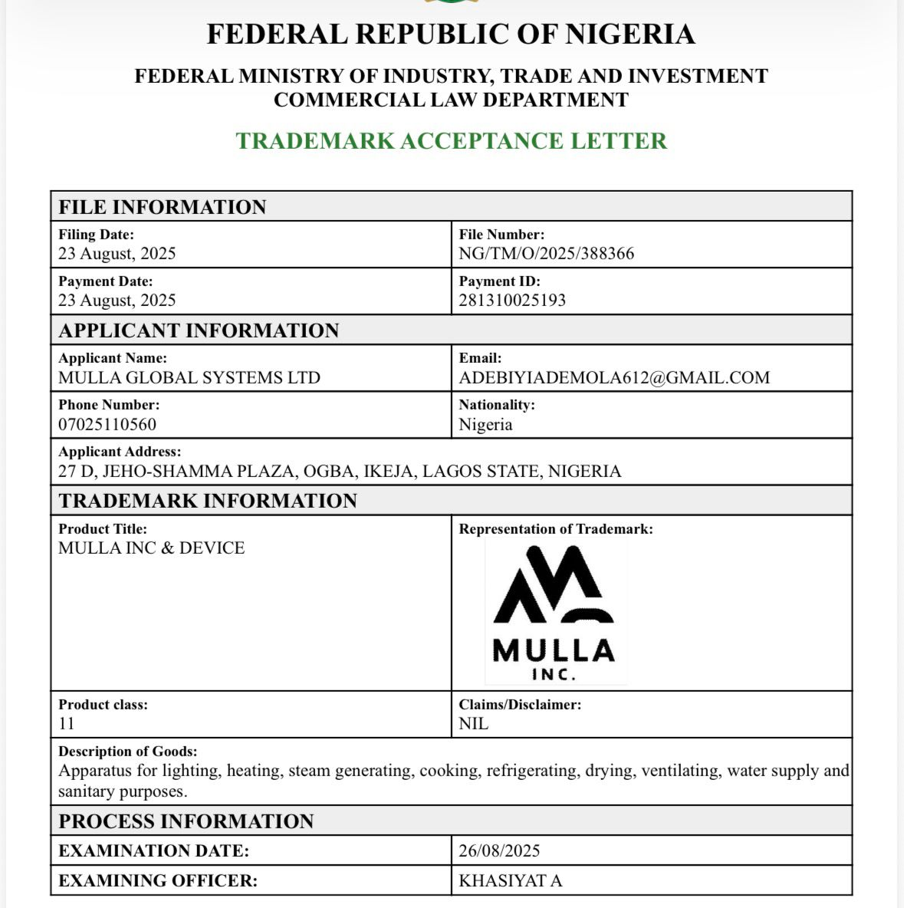
Business Registration/Licenses
Notes:
My company registration and Trademark certificate

Slide 13
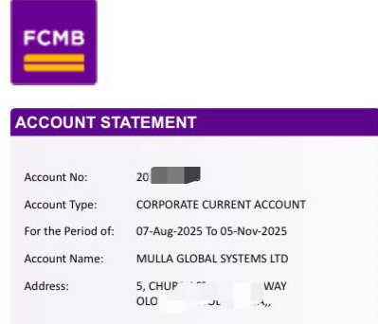
Please add a copy of your business bank account here. Please black out any account numbers, amounts, and other sensitive information.

